Slide 1



Malicious Honeypot
Modified honeypot that will attack intruders’ systems with the goal of taking control

Slide 2
Team Members
Nick Marquardt (marquans@mail.uc.edu)
John Velten (veltenjr@mail.uc.edu)
Alex Perkins (perkinax@mail.uc.edu)
Advisor: Dr. Franco (franco@ucmail.uc.edu)

Slide 3
Project Purpose
This project is an exploratory study in the realm of cybersecurity. Honeypots are tools that are widely used to learn about, track, and prevent threats to a system. Attackers are baited with a phony system and from here they can be blocked, or just tracked. Our goal is to implement a honeypot that can do all these things, but also return malicious code that will allow us to gain access to and control the attacker’s system.

Slide 4
User Stories
As a cybersecurity threat analyst, I want to be able to monitor attackers so that I can patch up vulnerabilities in my organization’s system.
As a computer science student, I want to be able to learn about ethical hacking so that I can apply this skill to my future career.

Slide 5
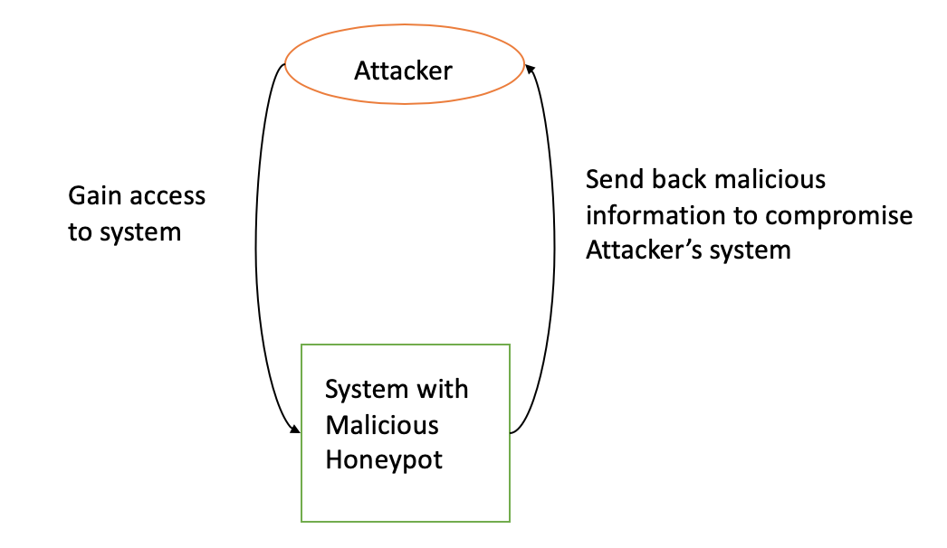
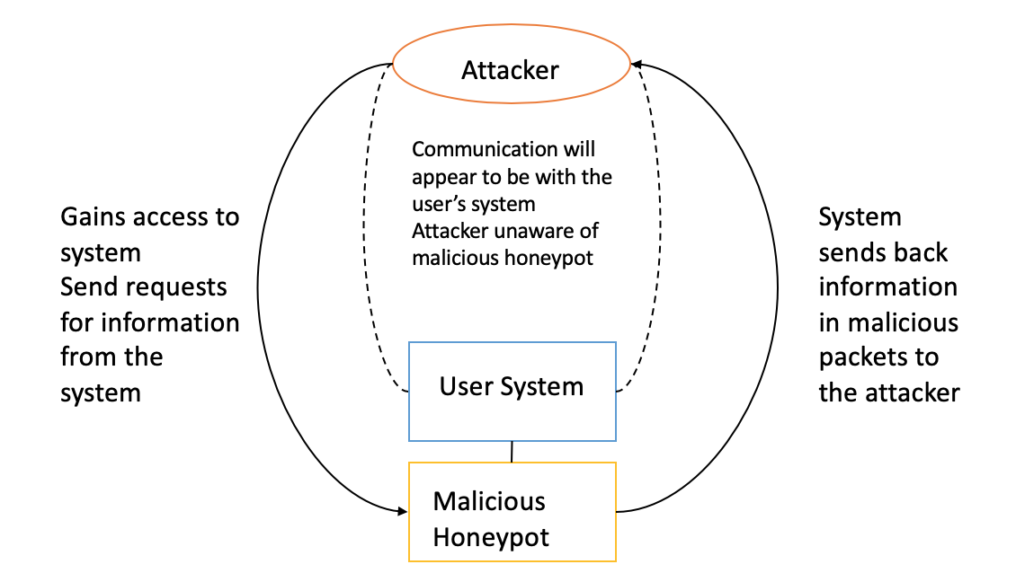
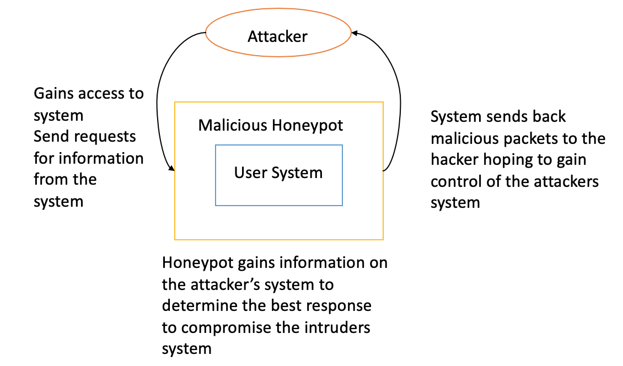
Design Diagrams
Level 0
Level 1
Level 2

Slide 6
Project Constraints
Ethics
Security
Hacking can be used in an ethical way, and this project is ethical for the most part. The part that gets questionable is that the honeypot is returning the favor to the attacker. It could be argued that this honeypot is just reciprocating the malice of the attacker. Ultimately, the extent of the damage done to the attacker will be the deciding factor in that argument.
Since the honeypot is being deployed, it will be especially visible to anyone looking to carry out nefarious acts. What happens if the attacker sees through the honeypot and is actually able to compromise the host? This, among other questions are still being addressed throughout the semester leading up to the full scale deployment of the malicious honeypot.

Slide 7
Current Progress: Research, SSH server, logger End of Term: Remote access to server, logger fully implemented, honeypot deployed
PHASE |  |  |  |  | DETAILS |  | FALL19 |  |  |  |  |  |  |  |  |  |  |  |  |  | FALL19/SPRING20 |  |  |  |  |  |  |  |  |  |  |  |  | SPRING20
 |  |  |  |  |  |  | AUG |  |  |  |  | SEP |  |  |  |  | OCT |  |  |  | NOV |  |  |  | DEC |  |  |  |  | JAN |  |  |  | FEB |  |  |  | MAR |  |  |  |  | APR
 |  | PROJECT WEEK: |  |  |  |  |  | 4 | 11 | 18 | 25 | 1 | 8 | 15 | 22 | 29 | 6 | 13 | 20 | 27 | 3 | 10 | 17 | 24 | 1 | 8 | 15 | 22 | 29 | 5 | 12 | 19 | 26 | 2 | 9 | 16 | 23 | 1 | 8 | 15 | 22 | 29 | 5 | 12 | 19 | 26
1 |  | Research |  |  | - Research |  |  |  |  |  |  |  | Research honeypots
 |  |  |  |  | - Research types |  |  |  |  |  |  |  |  |  | Interactivity lvl/ honeypot type
2 |  | Setting up environment & Honeypot |  |  | - Language selection |  |  |  |  |  |  |  |  |  |  | Lang.
 |  |  |  |  | - Evironment selection |  |  |  |  |  |  |  |  |  |  |  | Env.
 |  |  |  |  | - Begin logger |  |  |  |  |  |  |  |  |  |  |  |  |  |  |  | Logger
 |  |  |  |  | - Testing environment |  |  |  |  |  |  |  |  |  |  |  |  |  |  |  |  | Secure tests
 |  |  |  |  | - Deploy server |  |  |  |  |  |  |  |  |  |  |  |  |  |  |  |  |  |  | Server
 |  |  |  |  | - Honeypot functionality |  |  |  |  |  |  |  |  |  |  |  |  |  |  |  |  |  |  |  | Honeypot
3 |  | Malice in the Palace |  |  | - Winter break |  |  |  |  |  |  |  |  |  |  |  |  |  |  |  |  |  |  |  |  |  | Winter Break
 |  |  |  |  | - Implement malice |  |  |  |  |  |  |  |  |  |  |  |  |  |  |  |  |  |  |  |  |  |  |  |  |  | Getting malicous
 |  |  |  |  | - Spoof commands |  |  |  |  |  |  |  |  |  |  |  |  |  |  |  |  |  |  |  |  |  |  |  |  |  |  |  |  | Compromise w/ commands
 |  |  |  |  | - General enhancements |  |  |  |  |  |  |  |  |  |  |  |  |  |  |  |  |  |  |  |  |  |  |  |  |  |  |  |  |  |  |  | New features where applicable
4 |  | Final Stages |  |  | - Final testing |  |  |  |  |  |  |  |  |  |  |  |  |  |  |  |  |  |  |  |  |  |  |  |  |  |  |  |  |  |  |  |  |  |  |  |  | Testing
 |  |  |  |  | - Demo prep |  |  |  |  |  |  |  |  |  |  |  |  |  |  |  |  |  |  |  |  |  |  |  |  |  |  |  |  |  |  |  |  |  |  |  |  |  | Presenting

Slide 8
Division of Work
Nick Marquardt
John Velten
Alex Perkins
Determine interactivity and type
Determine environment for honeypot
Develop logging system
Deploy environment
Prepare project for demo/presentation
Implement honeypot in environment
Develop malicious methods
Implement spoof commands
Implement new features where applicable
Prepare project for demo/presentation
Determine optimal language for honeypot
Set up testing environment
Complete final testing
Prepare project for demo/presentation

Slide 9
Project Milestones
Launch server: We need to make sure we are developing in an environment that can be remotely reached for each group member. The server also needs to be accessible at coordinated times. We also need to be wary of attackers early on, so that we do not compromise any of our own systems.
Implement honeypot: Once we have a server up and running we need to actually turn it into a honeypot that looks like a legitimate system to attract attackers. We also need it to have the basic functionality of a honeypot like logging activity on the server.
Getting malicious: Once we have a functioning honeypot, we want to implement spoof commands along with some other functions. The spoof commands will be normal commands used in an SSH terminal that will actually be customized to do our (the developers) bidding. We also want to return some malicious code to the attacker in packets to compromise their system.
More functionality: After our malicious honeypot is running, we want to smooth out any edges and enhance the experience for whoever is using the honeypot. We are still unsure what this will entail, but are confident we will find plenty of things during development.

Slide 10
Expected Demo at Expo
Video of a mock attack carried out by one of the group members
Real time simultaneous recordings of the attacker and the honeypot
Finding a real attacker might be risky
No guarantee anyone will attack system

Slide 11
Music: “The Elevator Boss Nova” - https://bensound.com

